Slide 1

Final Project – Computer Science
Content:
- Introduction
- Problems & Topic’s importance
- Main codes
- Challenges
- Our work
- Result
- Q & A
Topic: CONVERTOR
Linh Nguyen
Cong Minh Nguyen
Xuan Dang Thi Linh

Slide 2

The temperature is 70 Fahrenheit, so that means how many Celsius ???
Problems:
- many different units to measure things
- different countries use different units
Topic’s importance (why we chose it):
- to convert unfamiliar units to the familiar ones
- able to apply the topic to normal life

Slide 3
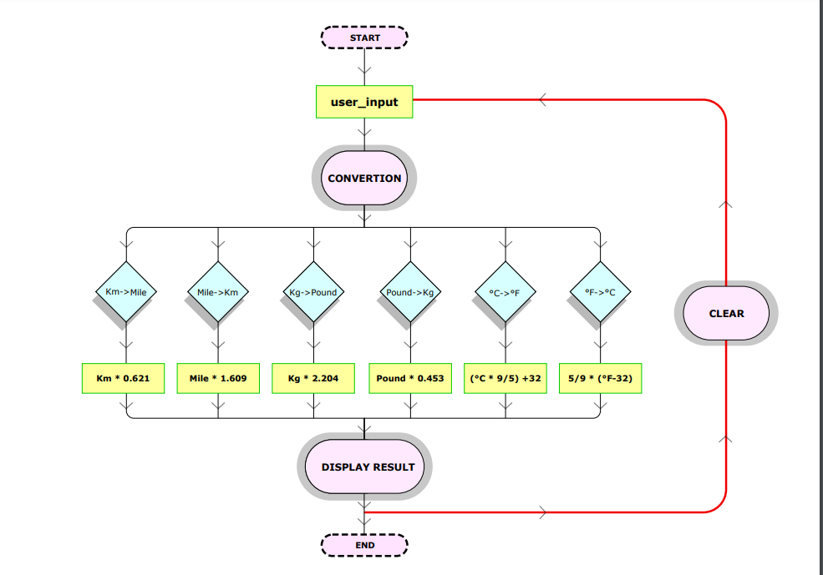
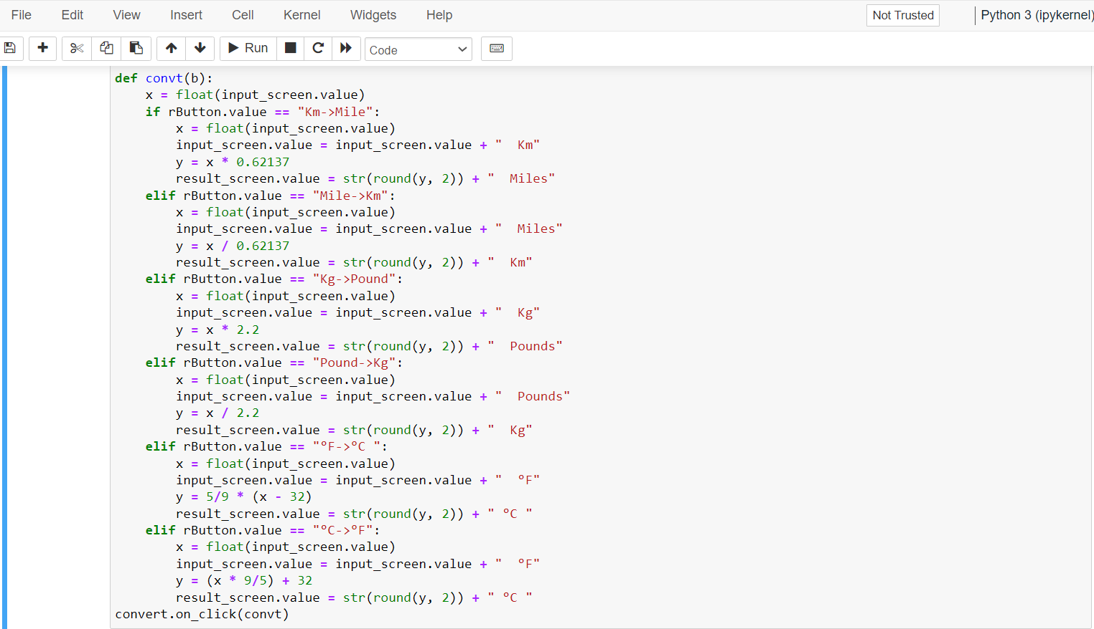
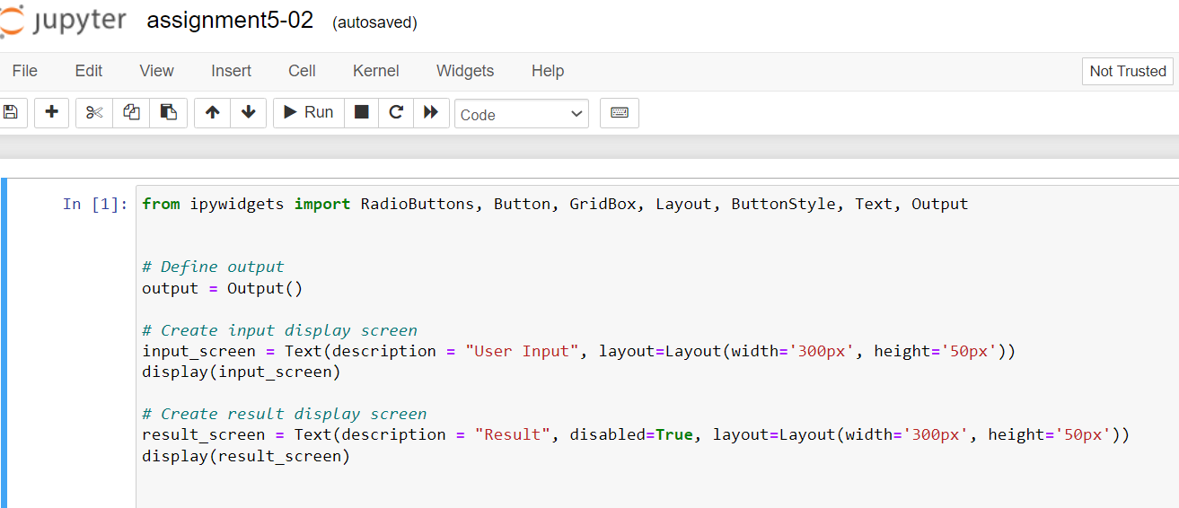
Some main codes
Those were used to create a display screen
Codes to create interactive buttons

Slide 4
Challenges
- Little experience
- Time limitations in research
- Unfamiliar syntaxes

Slide 5
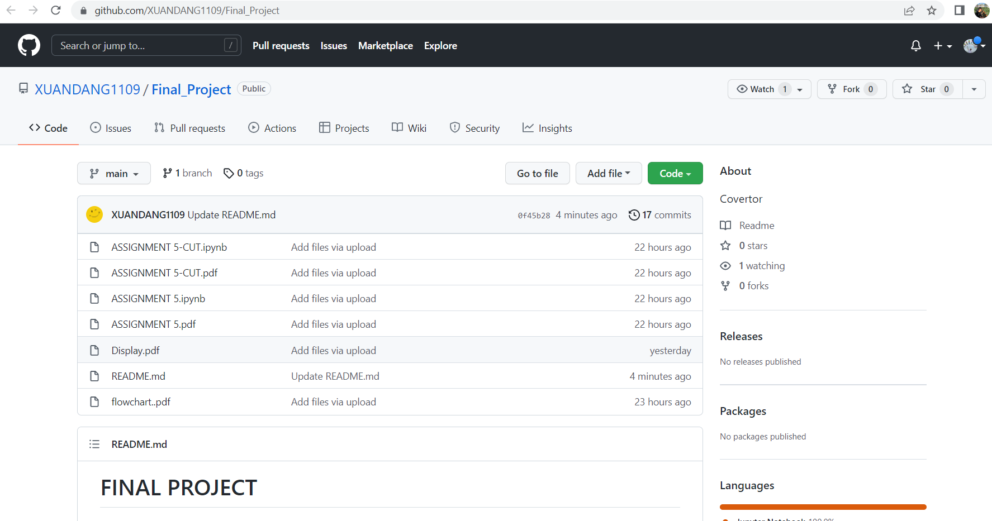
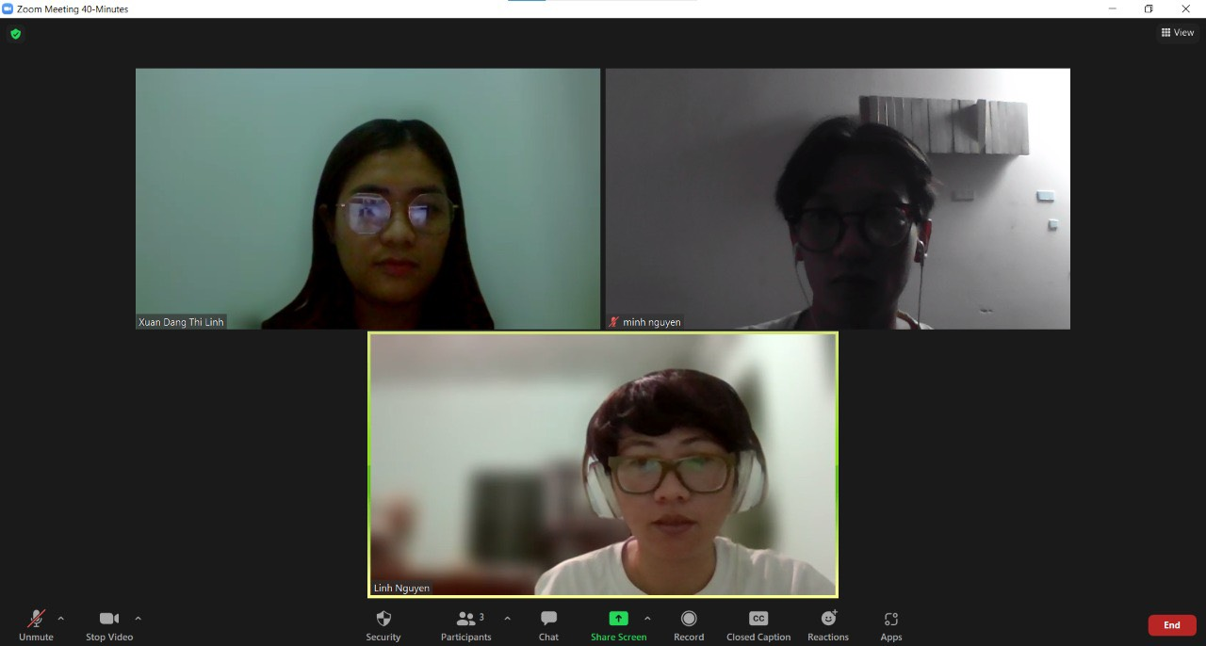
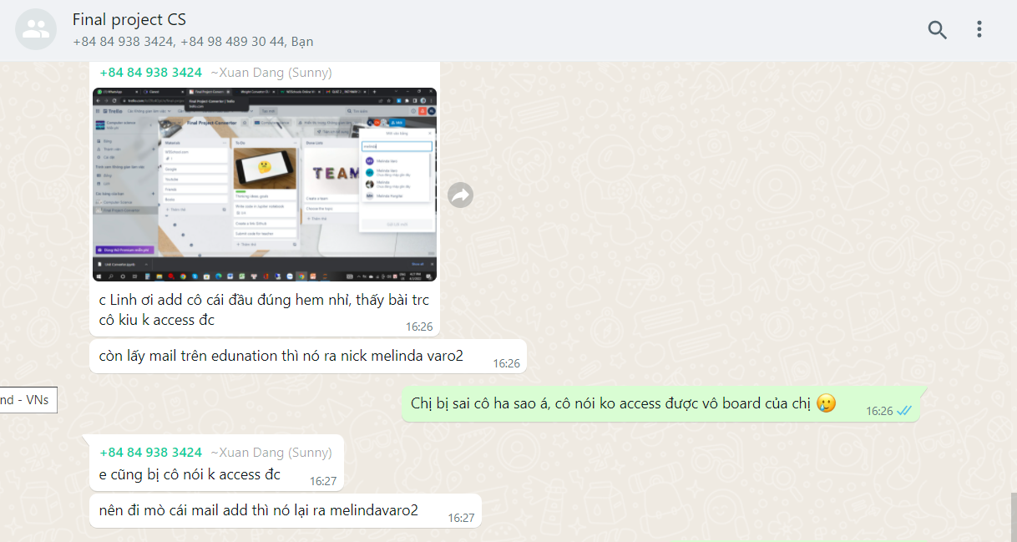
GitHub
follow-up
How did we solve those problems???
Zoom
meetings
Whatsapp communication

Slide 6
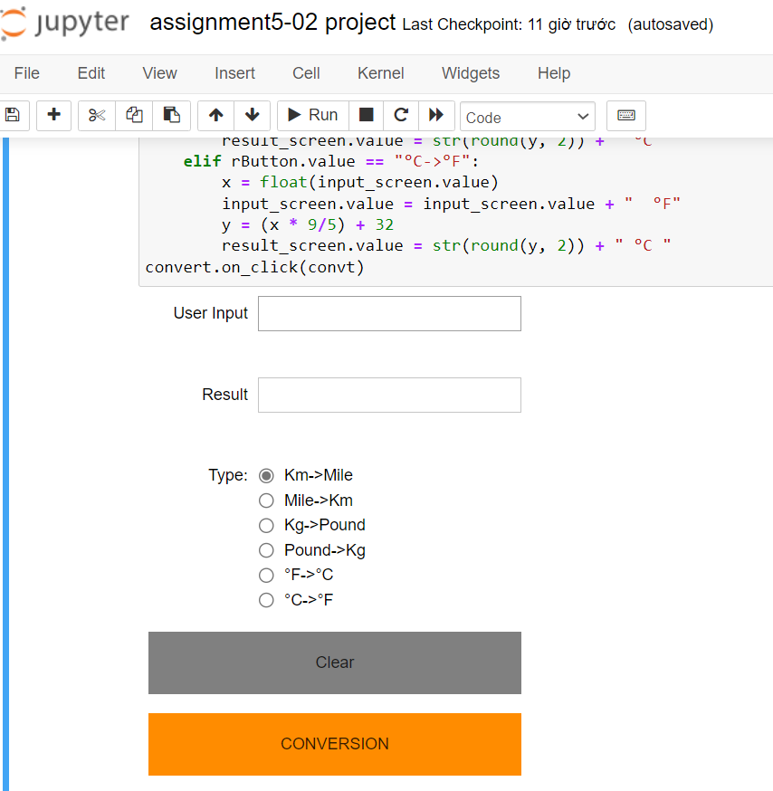
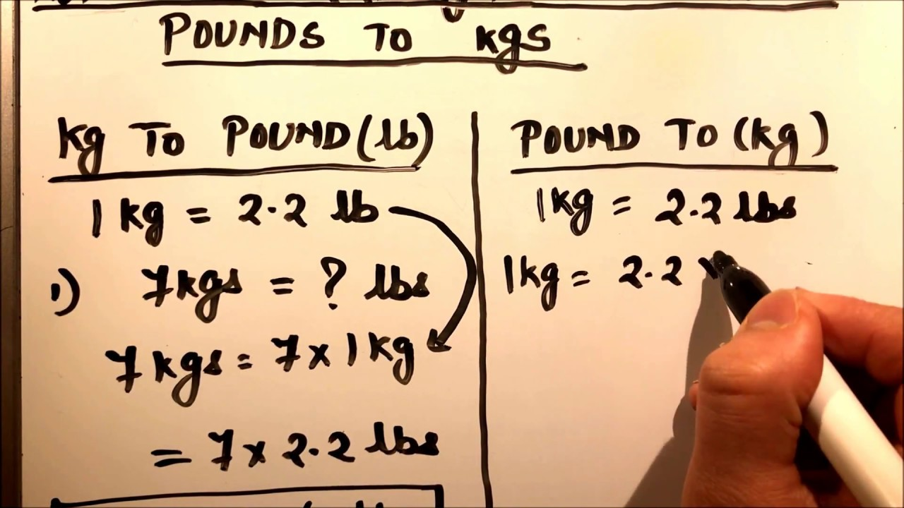
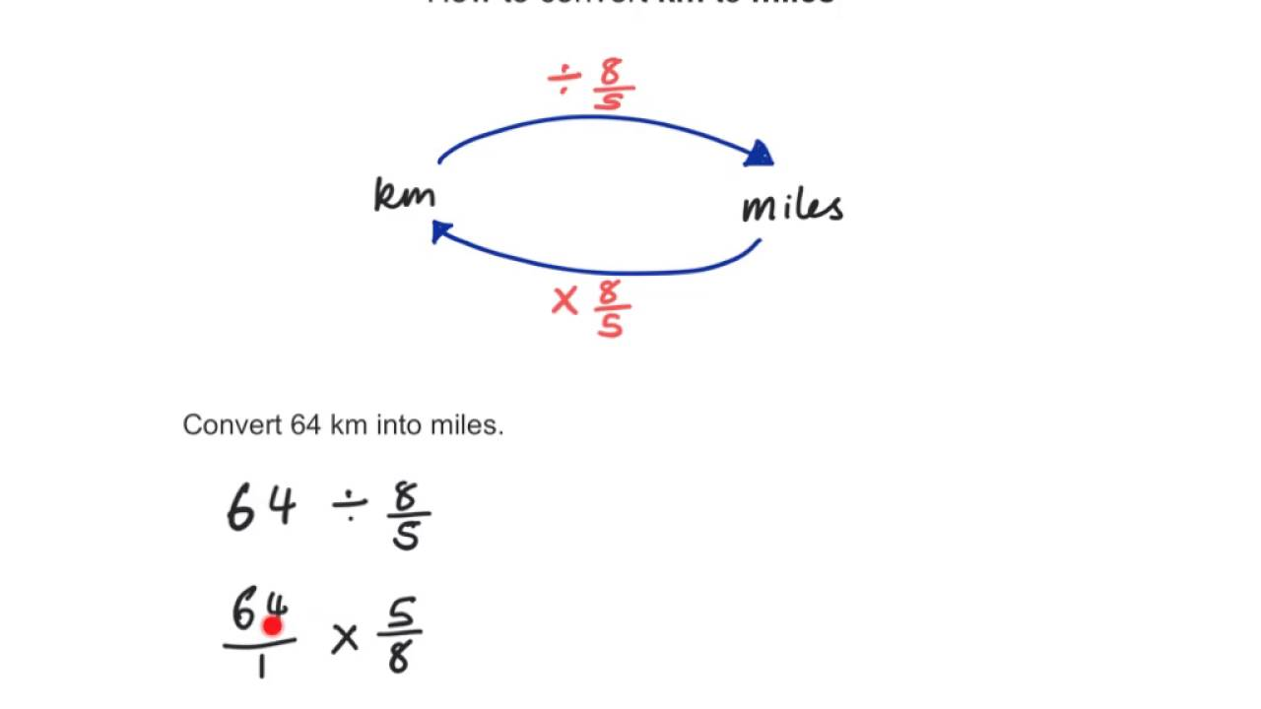
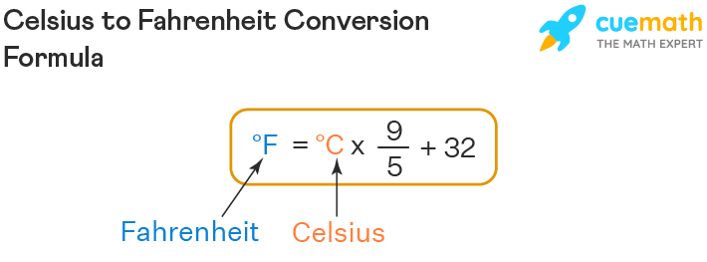
We don’t need to memorize those formulae to convert calculation units anymore!!!

Slide 7
THANK YOU FOR YOUR ATTENTION!!!
PLEASE DROP YOUR QUESTIONS AND COMMENTS HERE

